Slide 1
Update Management of Dengue
Professor Quazi Tarikul Islam Professor and Head Department of Medicine Popular Medical College
Editor in Chief
National Guideline for Clinical management
of Dengue Syndrome

Slide 2
Case 1: 2018
Male, 25 years
Presentation:
High grade fever – 3 days
Generalized bodyache
Headache
No systemic symptoms

Slide 3
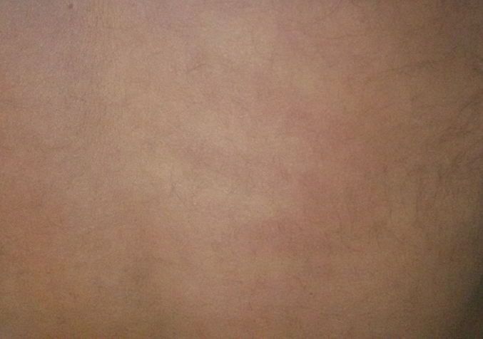
Physical examination:
Appearance: flushed
Temperature: 104° F
Skin: hyparaemic, blanch on pressure
Eyes: congested
Systemic examination: unremarkable

Slide 4
It is rainy season
Q. What is the most likely diagnosis?
A. Dengue is the most likely

Slide 5
Responsible dengue viral particles

Slide 6
Responsible vectors for CHIKV/DENV

Slide 9
I. Febrile Phase
The onset of dengue fever is usually with sudden rise in temperature which may be biphasic, lasting 2-7 days and commonly associated with headache, flushing and rash.
There may be pain in retro-orbital area, muscles, joint or bone. Rash may be maculopapular or rubelliform and usually appear after 3 or 4 day of fever and commonly seen
in face, neck and other part of the body which generally fades away in the later part of the febrile phase. Localized cluster of petechiae may appear over upper and lower
limbs.

Slide 10
II. Critical phase
DF/DHF patients usually go to critical phase after 3 to 4 days of onset of fever. During this critical phase plasma leakage and high haemoconcentration are documented and patients may develop hypotension.
Abnormal haemostasis and leakage of plasma leads to shock, bleeding, accumulation of fluid in pleural and abdominal cavity.
High morbidity and mortality in DHF/DSS are commonly associated with various organ involvements and metabolic derangement.
The period of plasma leakage usually persists for 36-48 hrs. Commonly in DHF, platelet count is less than 100000 per/cumm
of blood.

Slide 11
III. Convalescent phase
During the recovery phase the extracellular fluid which was lost due to capillary leakage returns to the circulatory system and signs and symptoms improve. This phase
usually after 6-7 days of fever and last for 2-3 days.
Longer convalescence may be expected in some of the patients with severe shock, organ involvement and other
complications which may require specific treatment.
Patient may develop pulmonary oedema due to fluid overload if the fluid replacement is not optimized carefully.

Slide 14
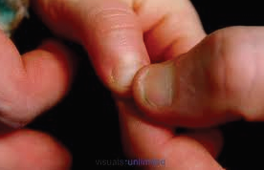

Slide 15
Dengue Shock Syndrome
Dengue Shock Syndrome
Significant loss of plasma leads to hypovolemic shock. Even in these shock cases,
prior to intravenous fluid therapy, pleural effusion and ascites may not be detected
clinically. Radiographic and ultrasound evidence of plasma leakage precedes clinical
detection. A right lateral decubitus chest radiograph to detect pleural effusion and
gall bladder wall oedema is associated with plasma leakage and may precede the
clinical detection.
Dengue Shock Syndrome is a presentation of Dengue Syndromes when there is
criteria of DHF plus signs of circulatory failure, manifested by:
• Rapid and weak pulse
• Narrow pulse pressure (≤ to 20 mm Hg)
• Hypotension for age
• Cold clammy skin
• Restlessness
• Undetectable pulse and blood pressure

Slide 16
Dengue Case Management

Slide 17
Warning Sign
No clinical improvement or worsening of the situation just before or
during the transition to afebrile phase or as the disease progresses.
Persistent vomiting.
Severe abdominal pain.
Lethargy and/or restlessness, sudden behavioural changes.
Bleeding: Epistaxis, black stool, haematemesis, excessive menstrual
bleeding, dark colored urine (haemoglobinuria) or haematuria.
Giddiness.
Pale, cold and clammy hands and feet.
Less/no urine output for 4 – 6 hours
Liver enlargement > 2cm
Haematocrit >20%

Slide 18
pregnancy
infancy
old age
obesity
diabetes mellitus
hypertension
heart failure
renal failure
chronic hemolytic diseases such as (sickle - cell disease
and autoimmune diseases)those with certain social
circumstances (such as living alone, or living far from a
health facility without reliable means of transport)

Slide 20
DENGUE CASE MANAGEMENT
ASSESSMENT
CASE CLASSIFICATION
GROUP
Group A: May be sent home
(Mild)
Group B: Refrered for Hospit al Care
(Moderate)
Presumptive Diagnosis
Live in/travel to endemic area plus
fever and two of the following
1. Anorexia & Nausea
2. Rash
3. Aches or pain
4. Warning sign
5. Leaukopenia
6. Tourniquet test positive
• No clinical improvement or worsening of the situation just
before or during the transition to afebrile phase or as the
disease progres ses.
• Persistent vomiting.
• Severe abdominal pain.
• Lethargy and/or restlessness, sudden behavioral changes.
• Bleeding: e pistaxis, black stool, ha ematemesis, excessive
menstrual bleeding, dark colored urine (haemoglobinuria) or
haematuria.
• Giddiness.
• Pale, cold and clammy hands and feet.
• Less/no urine output for 4 –6 hours
• Liver enlargement > 2cm
• Haematocrit >20%
Lab conrmed dengue ( Important
when no sign of plasma leakage )
Negative Positive
Dengue without Warning
Sign
Dengue with Warning
Sign
Severe Dengue
Co-existing condition
Social Circumstances
Negative
Positive
GROUP A
-Who may sent home
Group B
Referred for in -hospital care
MANAGEMENT
Group c riteria
Patient Who do not have warning
sign
AND
Who are able
- to tolerate adequate
amount of ORAL Fluids
- to pass urine at least once
in every 6 hours
Group criteria
Patients with any of the following features:
•Co-existing conditions such as pregnancy,
infancy, old age, diabetes mellitus
•Social circumstances such as living alone,
living far from hospital
OR
Existing warning signs:
o Abdominal pain or tenderness
o P ersistent vomiting
o Clinical 􀏐luid accumulation
o Mucosal bleeding
o L ethargy/ restlessness
o L i ver enlargement >2cm
o Laboratory: increase in Hct
Laboratoy tests
- Full Blood Count (FBC)
- Hematocrit (HCT)
Laboratory tests
o Full blood Count (FBC)
o H a e matocrit (Hct)
GroupC: Register for
Emergency Treatment
(Severe)
Group C
Require emergency treatment
Group criteria
•Patients with any of the
following features.
Severe plasma leakage with
shock and/or 􀏐luid accumulation
with respiratory distress
•Severe bleeding
•Severe organ impairment
•Severe Metabolic dysfunction
Laboratory tests
o Full blood Count (FBC)
o H a e matocrit (Hct)
o Other organ function
tests as indicated

Slide 21
GROUP A
-Who may sent home
Group B
Referred for in -hospital care
MANAGEMENT
Group c riteria
Patient Who do not have warning
sign
AND
Who are able
- to tolerate adequate
amount of ORAL Fluids
- to pass urine at least once
in every 6 hours
Group criteria
Patients with any of the following features:
•Co-existing conditions such as pregnancy,
infancy, old age, diabetes mellitus
•Social circumstances such as living alone,
living far from hospital
OR
Existing warning signs:
o Abdominal pain or tenderness
o P ersistent vomiting
o Clinical 􀏐luid accumulation
o Mucosal bleeding
o L ethargy/ restlessness
o L i ver enlargement >2cm
o Laboratory: increase in Hct
Laboratoy tests
- Full Blood Count (FBC)
- Hematocrit (HCT)
Laboratory tests
o Full blood Count (FBC)
o H a e matocrit (Hct)
GroupC: Register for
Emergency Treatment
(Severe)
Group C
Require emergency treatment
Group criteria
•Patients with any of the
following features.
Severe plasma leakage with
shock and/or 􀏐luid accumulation
with respiratory distress
•Severe bleeding
•Severe organ impairment
•Severe Metabolic dysfunction
Laboratory tests
o Full blood Count (FBC)
o H a e matocrit (Hct)
o Other organ function
tests as indicated

Slide 22
GroupC: Register for
Emergency Treatment
(Severe)
Group C
Require emergency treatment
Group criteria
•Patients with any of the
following features.
Severe plasma leakage with
shock and/or 􀏐luid accumulation
with respiratory distress
•Severe bleeding
•Severe organ impairment
•Severe Metabolic dysfunction
Laboratory tests
o Full blood Count (FBC)
o H a e matocrit (Hct)
o Other organ function
tests as indicated

Slide 23
33
4.3.1 Group A
These patients will be advised to
adequate bed rest
adequate fluid intake (> 6 glasses for an average-sized adult, or
accordingly in children) - e.g. milk, fruit juice (caution
with diabetes patient), oral rehydration solution (ORS) or
barley/rice water/coconut water Note: Plain water alone
may cause electrolyte imbalance
take paracetamol (not more than 3 grams per day for adults; 10-15
mg/kg/dose, not more than 3 to 4 times in 24 hours in children)
Tepid sponging
look for mosquito breeding places in and around the home and
eliminate them
These patients will be advised to avoid
Acetylsalicylic acid (aspirin), mefenemic acid , ibuprofen or other
NSAIDs
Steroids
Antibiotics
If any of following is observed, the patient should be immediately taken to the nearest
hospital; these are warning signs for danger:
Bleeding:
− red spots or patches on the skin
− bleeding from nose or gums
− vomiting blood
− black-coloured stools
− heavy menstruation/vaginal bleeding
Frequent vomiting or not able to drink
Severe abdominal pain
Drowsiness, mental confusion or seizures
Pale, cold or clammy hands and feet
Difficulty in breathing
Postural dizziness
No urine output for 4–6 hours

Slide 24
Management of Patients in Group B
Obtain a reference haematocrit before intravenous fluid therapy
begins.
Intravenous fluid therapy in DHF during the critical period
Indications for IV fluid:
when the patient cannot have adequate oral fluid intake or is vomiting. when
HCT continues to rise 10%–20% despite oral rehydration.
impending shock/shock.
The general principles of fluid therapy in DHF include the following:
The following fluids are recommended both crystalloids and colloids
Crystalloids
1. 0.9% Nacl (isotonic normal saline solution) (0.9%NS) (Preferable)
2. 0.45% half strength normal saline solution (0.45%NS) (For children)
3. 5% dextrose in lactated Ringer's solution (5%DRL)
4. 5% dextrose in acetated Ringer's solution (5%DRA)
5. Hartman solution (Preferable)
Colloids
1. Dextran 40
2. Hemaceel
3. Plasma
4. Blood & Blood Components
5. Human Albumin
Isotonic crystalloid solutions should be used throughout the critical period except in
the very young infants <6 months of age in whom 0.45% sodium chloride may be used.
Give only isotonic solutions such as 0.9% saline, Ringer's lactate or Hartmann's or
Lactate solution
Hyper-oncotic colloid solutions (osmolarity of >300 mOsm/l) such as dextran 40 or
starch solutions may be used in patients with massive plasma leakage, and those not
responding to the minimum volume of crystalloid. Iso-oncotic colloid solutions such as
blood and blood component may not be as effective.
A volume of about maintenance +5% dehydration should be given to maintain “just
adequate” intravascular volume and circulation. The duration of intravenous fluid
therapy should not exceed 24 to 48 hours for those with shock. However, for those
patients who do not have shock, the duration of intravenous fluid therapy may have to
be longer but not more than 60 to 72 hours. This is because the latter group of patients
has just entered the plasma leakage period while shock patients have experienced a
longer duration of plasma leakage before intravenous therapy is begun.

Slide 25
In obese patients, the ideal body weight should be used as a guide to calculate the
fluid volume
Fluid Requirement:
The fluid requirement, both oral and intravenous, in critical
phase (48 hours) is calculated as M+5% (maintenance + 5%
deficit).
5% deficit is calculated as 50 ml/kg up to 50kg.
Calculations for normal maintenance of intravenous fluid Infusion:
Normal maintenance fluid per hour can be calculated on the basis of the
following formula* (equivalent to Holliday - Segar formula):
4 ml/kg/hr for first 10 kg body weight
+ 2 ml/kg/hr for next 10 kg body weight
+ 1 ml/kg/hr for subsequent kg body weight
*For overweight/obese patients calculate normal maintenance fluid based
on ideal body weight (IBW), using the following formula:
Table 8 :Estimated ideal body weight for overweight or obese
Table 9 : Requirement of fluid based on ideal body weight:
150 50 45.5
160 57 52
170 66 61.5
180 75 70
Height (cm)
Estimated IBW for adult
male(kg)
Estimated IBW for adult
female(kg)
Ideal wt
(kg)
Maintenance
(ml)
M+5% decit
(ml)
Ideal body
wt(kg)
Maintenance
(ml)
M+5% decit
(ml)
5 500 750 35 1800 3550
10 1000 1500 40 1900 3900
15 1250 2000 45 2000 4250
20 1500 2500 50 2100 4600
25 1600 2850 55 2200 4950
30 1700 3200 60 2300 5300

Slide 26
Fluid Management of Patients in Group B:
deficit (oral and IV fluid together), to be administered over 48 hours. For example, in a
child weighing 20 kg, the deficit of 5% is 50 ml/kg x 20 = 1000 ml. The maintenance is
1500 ml for one day. Hence, the total of M + 5% is 2500 ml. This volume is to be administered
over 48 hours in non shock patients. The rate of IV replacement should be
adjusted according to the rate of plasma loss, guided by the clinical condition, vital
signs, urine output and haematocrit levels.
The admitted patient (Catagory B) should be started with recommended fluid at a rate
of 1.5ml/kg/hr or 40ml/hr (12 d/min) for adults and should be given for 6 hours. If
patients vital signs is stable, then the escalation of fluid is not needed and the same
rate can be maintained for a period of 48 hours.
If patient started with 1.5ml/kg/hr (adult 40ml/hr) for 6 hours doesn’t have stable vital
signs and adequate urine output, the fluid should be escalated to 3ml/kg/hr (adult
80ml/hr or 20 drops/min) for another 6 hours. This fluid can be escalated to
5ml/kg/hr (adult 120ml/hr or 30d/min and then upto 7ml/kg/hr or adult 200ml/hr or
50d/min) if every 6 hours doesn’t have stable vital sign or urine output.
Patient should be monitor every 2 hours with special attention to vital signs, urine
output, respiratory signs and haematocrit etc. In 6 hours of escalation, if patient
become stable regarding clinical parameters, the fluids can be gradually decline from 7
to 5 to 3 to 1.5 (ml/kg /hr) or from stages where he was stable. But the fluids should be
main tained always for at least 48 hours

Slide 30
Dengue Cases and Death- 2000 to September 2018

Slide 31
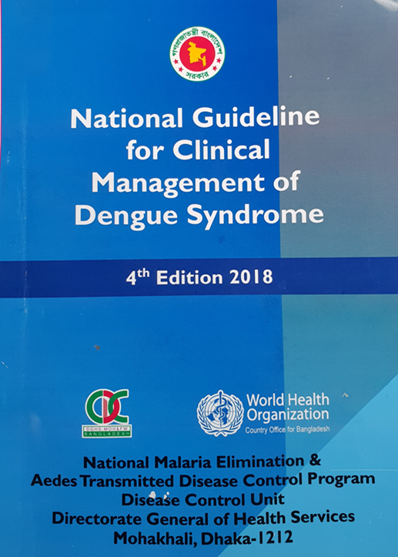
Updates on National Guidelines

Slide 32
Dengue: A Practical Experience of Medical Professionals in Hospital
50 cases: 25- CDF, 22- DHF, 3 – DF with unusual bleeding
Common clinical features : Fever, Headache ,Myalgia,
Anorexia, Vomiting, Ithcing
Unusual features: Abdominal pain, Diarrhoea, Hepatomegaly,
Ascites, Pleural effusion
Observation: Linear relationship between platelet count
and SGOT level ( p – 0.037)
Haematocrit is good predictor to differentiate
different presentation of Dengue Fever
Islam QT, Basher A, Amin R
J Medicine 2012; 13 : 160-164

Slide 33
Regional Situation

Slide 34
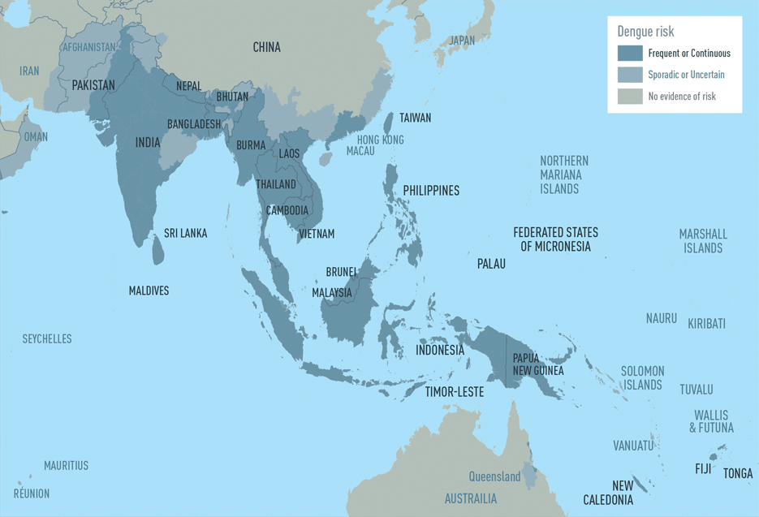

Slide 36
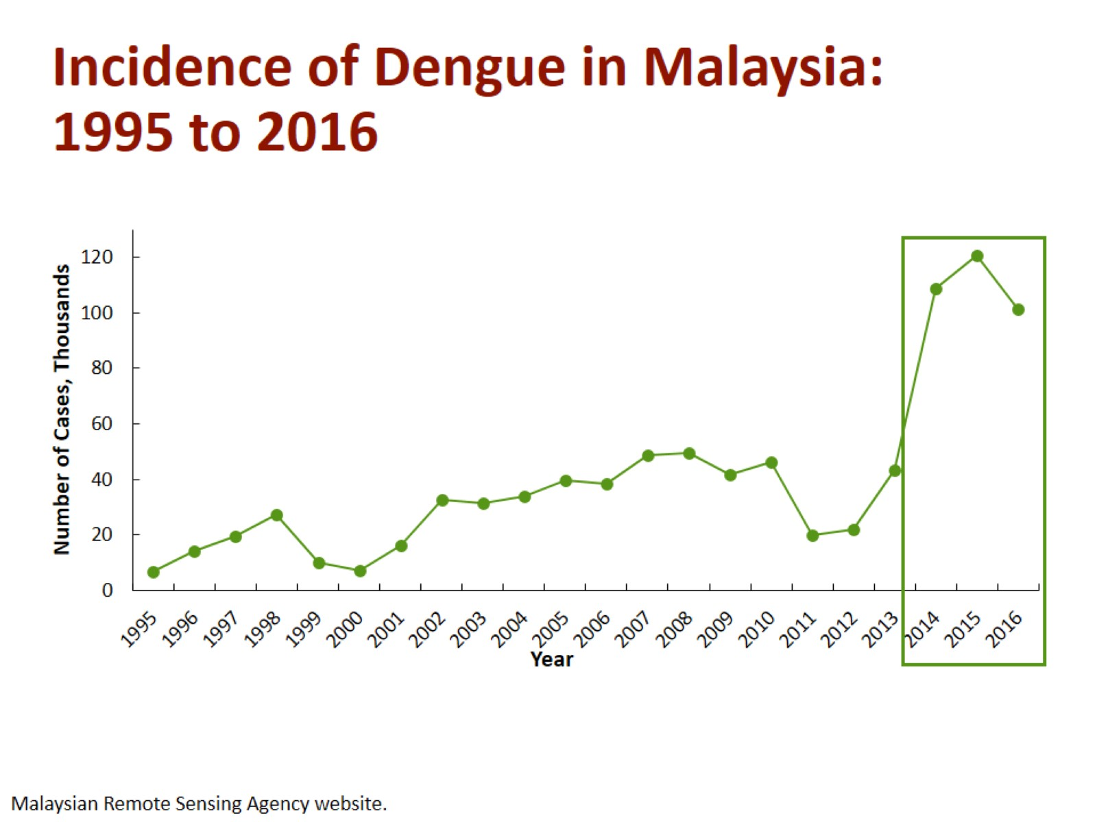

Slide 37
Struchiner CJ, Rocklöv J, Wilder-Smith A, et al. Increasing Dengue Incidence in Singapore over the Past 40 Years: Population Growth, Climate and Mobility. PLoS ONE 2015;10(8):e0136286.

Slide 38
MYANMAR
In 2001, Myanmar (Burma) had its largest outbreak of
dengue—15,361 reported cases of dengue hemorrhagic
fever/dengue shock syndrome (DHF/DSS), including 192
deaths. That year, 95% of dengue viruses isolated from
patients were serotype 1 .
Hlaing Myat Thu et al
Emerging Infectious Diseases • www.cdc.gov/eid • Vol. 10, No. 4, April 2004

Slide 39
MYANMAR
2011 and 2015, there were a total of 89,832 cases and 393 deaths in hospitals, with 97% of cases being in children.
The burden of dengue, source reduction measures, and serotype patterns In Myanmar, 2011 to 2015
Oo et al. Tropical Medicine and Health (2017) 45:35

Slide 40
Weekly trends of reported dengue cases in Maldives, 2010 to 2012
Source: Centre for Community Health and Disease Control,
Epidemiology and Surveillance Unit, MoH

Slide 41
Global scenario

Slide 43
Dengue and dengue hemorrhagic fever: global
Dengue and DHF is endemic in more than 128 countries in the WHO regions of
Africa
Americas
Eastern Mediterranean
South-East Asia and
Western Pacific
The South-East Asia and Western Pacific regions are the most seriously affected

Slide 44
Dengue and dengue hemorrhagic fever: global
Some 3.9 billion people – half of the world's population in tropical and subtropical countries are at risk
An estimated 50 million dengue infections occur worldwide annually
An estimated 500 000 people with DHF require hospitalization each year and about 2.5% of those affected die

Slide 47
Dengue in the Americas
1980-2011
Year 2010
COLOMBIA 157.152
VENEZUELA 123.967
BRAZIL 1.004.392
HONDURAS 66.814
GUADALUPE 41.000
PUERTO RICO 21.298
Year 2008
RIO DE JANEIRO
156.555 DF
Year 2007
PARAGUAY 28.182
MÉXICO 48.436
VENEZUELA 80.646
BRAZIL 559.954
Year 2002
HONDURAS 32.269
COLOMBIA 76.996
VENEZUELA 37.676
BRAZIL 780.644
Year 2011
BRAZIL 742.364
MEXICO 66.617
PARAGUAY 41.445
Year 1998
MEXICO 23.639
COLOMBIA 63.182
VENEZUELA 37.586
BRAZIL 535.388
Year 1981
CUBA 344.203
Year 2009
ARGENTINA 26.612
BOLIVIA 82.159
MEXICO 165.748
COLOMBIA 71.079
VENEZUELA 65.869
BRAZIL 528.883
2003: CD44.R9 PAHO
Source: Annual country reports to PAHO
2007: CSP27.R15.
2001: CD43.R4
150th Directive Council.
Notes:
In the last 28 years, dengue has experienced an increasing trend regarding number of cases, with epidemic peaks which are repeated every 3 to 5 years. Every epidemic peak has been regularly bigger than the preceding one, being the 2010 epidemic the greatest one. The reason behind these trends could be thought to be associated with the accumulation of susceptible individuals, with the circulation of different serotypes and perhaps to the increased virulence and patogenicity of circulating strains. Environmental factors have surely played an important role, creating optimal conditions for breeding sites, thus increasing the number of vectors.
Nowadays, and despite all efforts currently been undertaking, the situation is rather complex. Countries, within the framework of the IMS dengue often declare the state of emergency and this triggers funds release and response actions.

Slide 48
Average number of Dengue cases reported to WHO per year

Slide 49
As dengue virus is transmitted by Aedes mosquito, which is also responsible for transmission of other viruses including chikungunya, it was anticipated that chikungunya outbreak will occur in Bangladesh

Slide 50
Changing Pattern
Dengue fever and dengue haemorrhagic fever
epidemiological changes
The epidemiology of DF/DHF is complex and remains poorly understood. It involves host, viral and vector status that are further influenced by demographic, economic, behavioural and varied societal factors.
Rajesh Bhatia, Aditya P Dash, Temmy Sunyoto Web Publication,Review. Changing epidemiology of dengue in South-East Asia
Vol-2,(1), Aug-2013. Department of Communicable Diseases, World Health Organization/South East Asia Regional Office (SEARO), New Delhi, India

Slide 51
A.Changes in human host
Shift in affected‑age group
clinical DF in adults is rare. However, there is an evidence of increase of dengue incidence in older age groups, and this age shift has been reported Singapore, Indonesia, Bangladesh and Thailand.

Slide 52
B. Changes in the dengue virus
a.Virulence affecting severity of the disease
Sequential infections or secondary infections are important to determine the severity of the disease.
The infection enhancement contributes to the pattern of variable‑sized outbreaks observed.

Slide 53
Studies in Thailand have revealed the following quantum of DHF risk with different sequences of dengue viruses with DENV‑1/ DENV‑2: 500‑fold,
DENV‑3/DENV‑2: 150‑fold and
DENV‑4/DENV‑2 equals to 50‑fold risk.
b.Genotype affecting time interval between sequential infections

Slide 54
C.Changes In the vector bionomics
Rural spread
Seasonality and climate variability
Socio‑cultural and socio‑economic factors affecting vector longevity and survival

Slide 55
This year (2018) Out break Observation
Less rash
More Leucopenia
High AST
Tourniquet test +ve early
Diarrhea
Pharyngeal congestion
Ascites/ pleural effusion

Slide 56
Dengue expanding- why?
Global warming and climate change: with a 2°C increase in temperature the incubation period of DENV will be shortened, mosquitoes will bite more frequently because of dehydration
Extensive vector infestation, with declining vector control
Unreliable water supply systems
Increasing non-biodegradable containers and poor solid waste disposal
Increased air travel
Increasing human population density in urban areas

